Slide 2
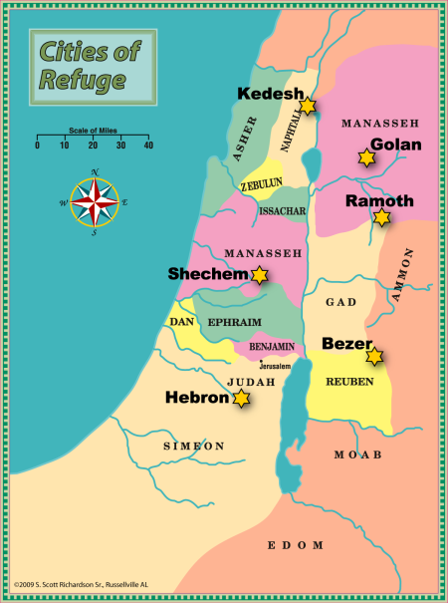

Slide 3
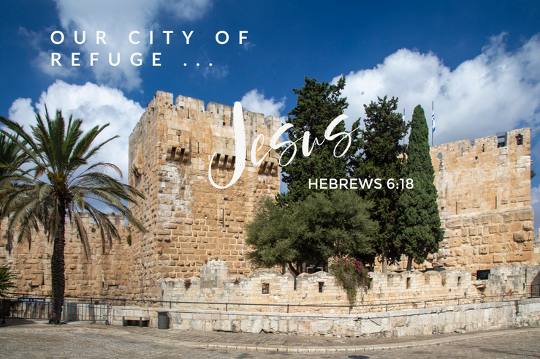

Slide 4

THE CITIES OF REFUGE WERE A PROVISION OF MERCY
Death is the penalty for sin – Romans 6:23
Since ALL sinned, we all need a place of refuge – Romans 2:23
Just as salvation found in cities of refuge, salvation found in church – Acts 2:47; Ephesians 2:11-22
THE CITIES OF REFUGE WERE WITHIN REACH AND ACCESSIBLE TO ALL
Gospel preached to ALL men – Mark 16:15
God is no respecter of persons – Acts 10:34,35
Gospel power to save – Romans 1:16
Grace appeared to ALL men- Titus 2:11

Slide 5
THE CITIES DESIGNATED AND ROADS WELL MARKED
Jesus is the way – John 14:6
Way into His body well marked – Acts 2:38; Mark 16:16; 1 Corinthians 12:13
SLAYER SAFE ONLY IN THE CITY OF REFUGE
One city was not as good as another!
Couldn’t pick the “city of your choice.”
Salvation ONLY found in the church Jesus built – Matthew 16:18
SAFETY ONLY IN THE CITY
One must ABIDE in Christ – John 15:6,7
2 Peter 2:20-22 “A dog returns to his own vomit..”

Slide 6
ARE YOU IN THE CITY OF REFUGE?
THE CHURCH OF CHRIST?
IF NOT
YOU ARE UNDER A DEATH SENTENCE
Romans 6:23
“For the wages of sin is death…”

Slide 7

You Need To Flee to it and Never Leave it

